Slide 1
Amrita Vishwa Vidyapeetham, Amaravati Campus
Artificial Intelligence and Robotics
19CSE455
Feasibility Analysis & Experimental Study of a Turret Gun Control System.
Name of the Student | Roll No.
Danda Vamsi Chakradhar | AV.EN.U4CSE22215
Puvvada Vamsidhar | AV.EN.U4CSE22237
Raghavarapu Dharani | AV.EN.U4CSE22238

Slide 2
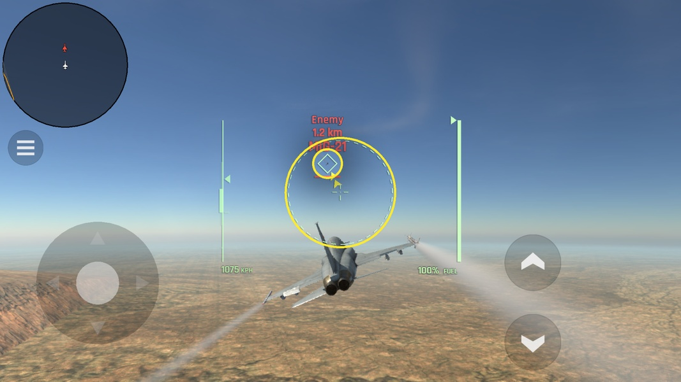
Introduction
An Automated Turret System is a defensive type of smart system which can detect, track, and target objects without any human intervention. This type of system is usually and mostly used in Defense, gaming and security. In military it helps to watch over the restricted areas to alert if there is any danger and also to eliminate those threats. And coming to gaming it is used in simulated games like MetalStorm to shoot out the jets in the range.
The main benefits of this system can be high accuracy as it decreases the human error, and also fast response to complement the human reflexes, and also the safety for the humans as the heavy gun machinery can really effect the human body because of the recoil of the guns.
To enhance targeting precision, adaptive Kalman filters are used to estimate the target’s position even in the presence of noisy signals or uncertain measurements. As explored in the work of [1] Donghoon Kim et al., Kalman filtering techniques, combined with Savitzky-Golay filtering, improve motion estimation accuracy by handling dynamic variations effectively.
This project aims to develop a simulation of an automatic turret that tracks and fires the bullet with high accuracy. The system will use a Kalman filter for tracking, a predictive firing mechanism, and collision detection algorithms to evaluate performance.

Slide 3
Problem Statement, Objectives and Programming Language
Problem Statement:
The goal of this project is to design and develop an AI-powered turret control system capable of automatically detecting, tracking, and targeting moving objects in real-time. The system will utilize a camera to capture video frames, process the image to identify and locate targets, and then calculate the necessary movement commands to adjust the turret's yaw and pitch to aim precisely at the detected target.
Objective:
Implement a control system that adjusts the turret's yaw (horizontal) and pitch (vertical) to track and aim at the detected target.
Programming Languages and Tools Used:
Used Deep Leaning Toolbox, Arduino Support Package, Python for Computer Vision and Image Preprocessing.

Slide 4
Methodology
Simulation Setup:
Define the total duration, time steps, Position of the turret and the speed of bullet.
Simulate the jet’s path with a sinusoidal wave for testing.
Kalman Filter Initialization:
First define the motion and measurement models.
Then initialize noise values of measurement and process.
Simulate The Execution:
Find the jet’s position and add noise to it.
Now predict the position through the help of Kalman Filter.
And adjust it for sudden movement jumps.
Smooth the path using the method named Savitzky-Golay Filter.
Track the bullet movement and mark it as a hit if the distance between the jet and the bullet is less than 0.75.
Now show the graph which depicts the jet’s path, predicted path, hit points and bullet movement.

Slide 5
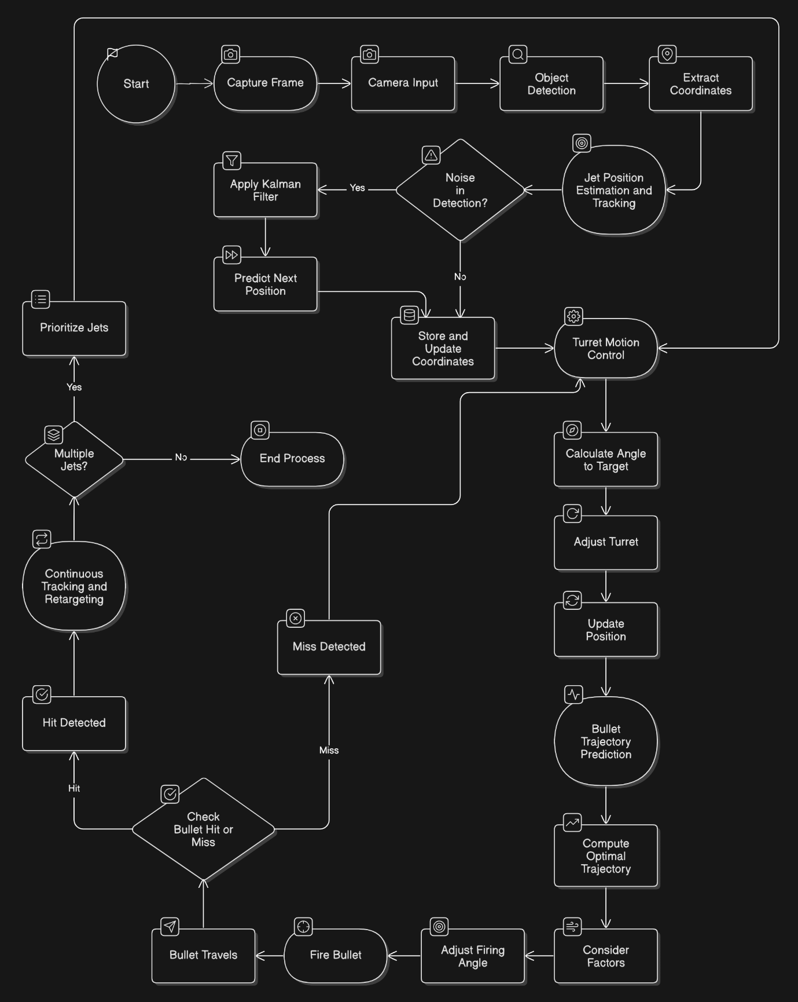
Flow-chart

Slide 6
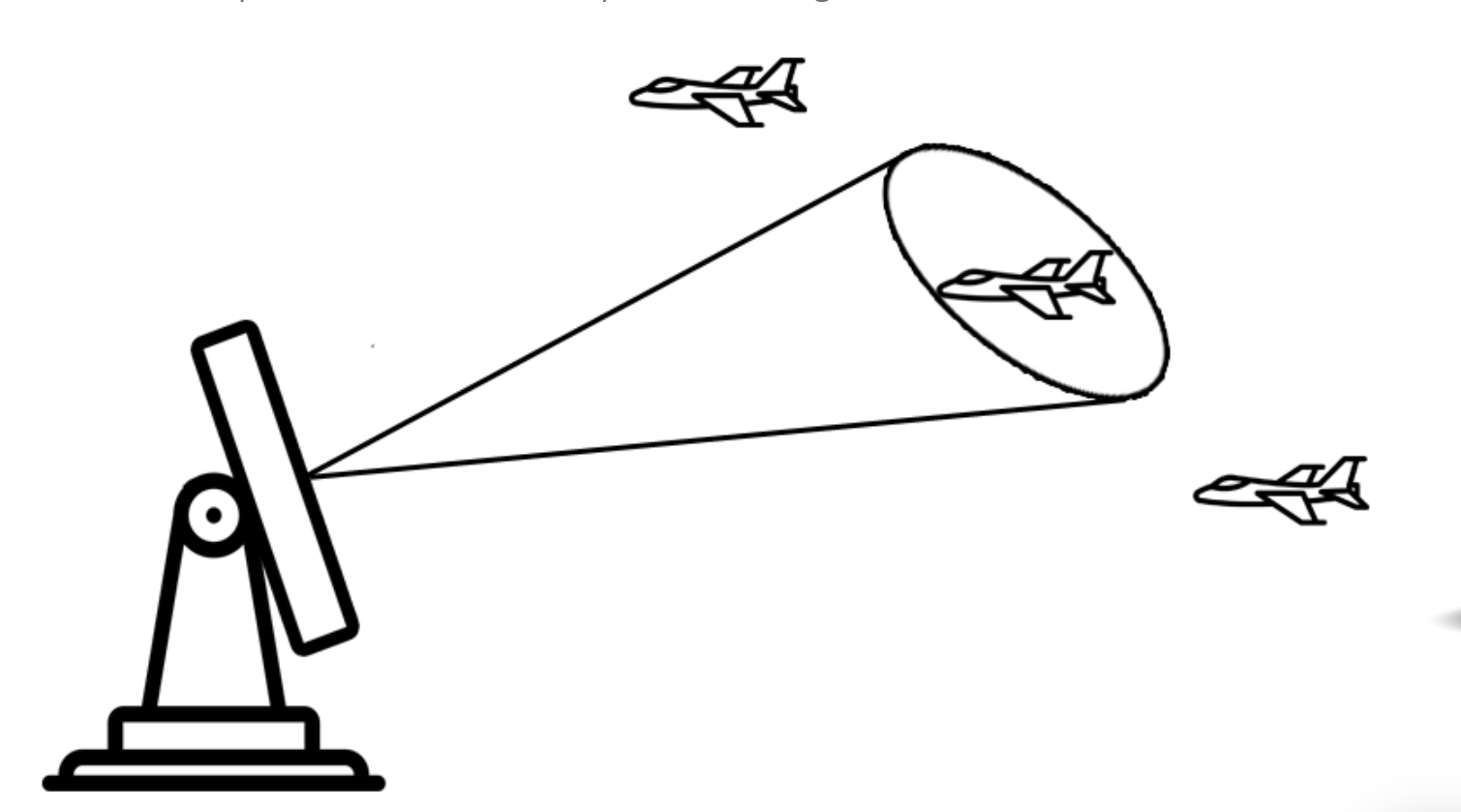
Filters
Kalman Filter Working
Newton’s motion equations: x=x0+v0Δt+(1/2)aΔt System State: [x,y,z,vx,vy,vz,ax,ay,az]
Working of Savitzky-Golay Filter
Linear Least squares

Slide 7
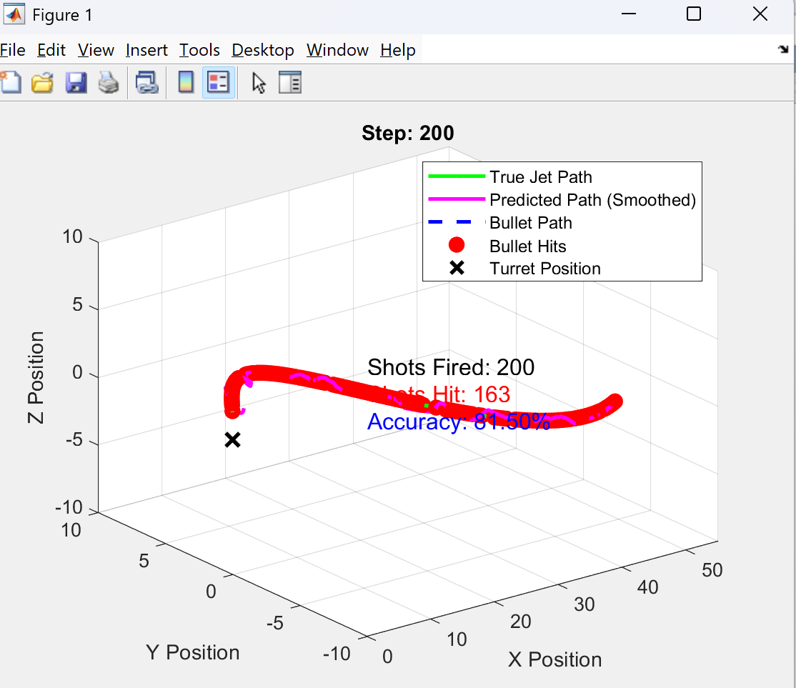
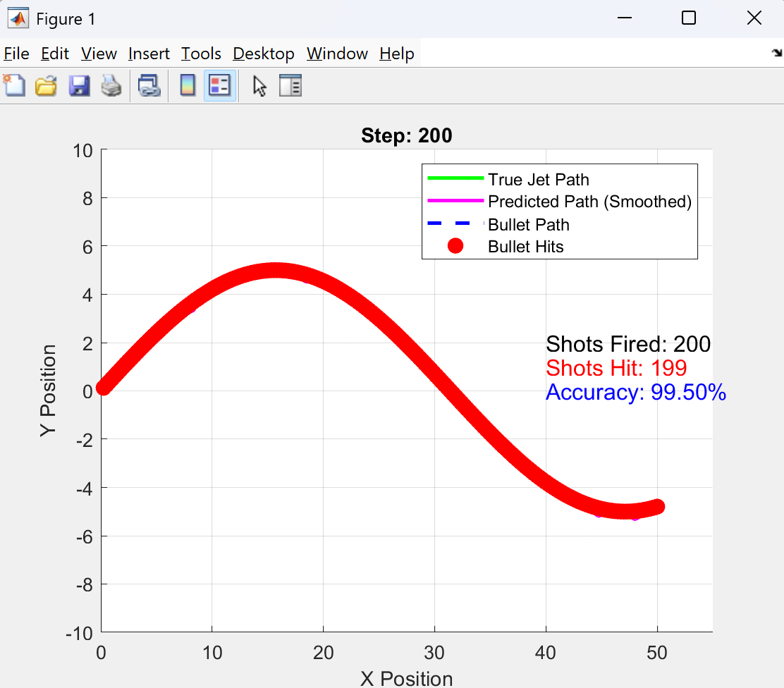
Simulation Result
2D Visualized output with reduced noise
3D Visualization output

Slide 8
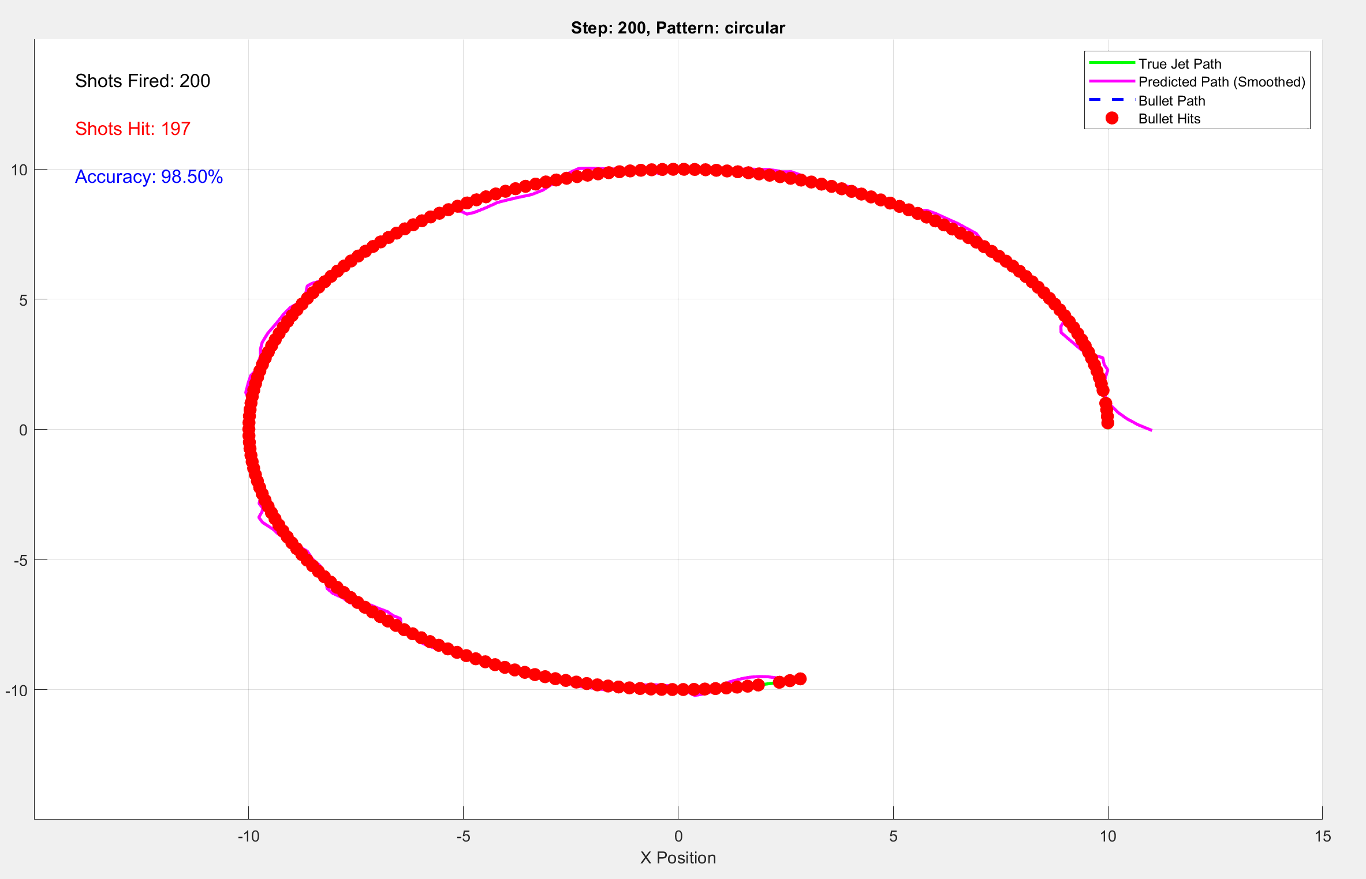
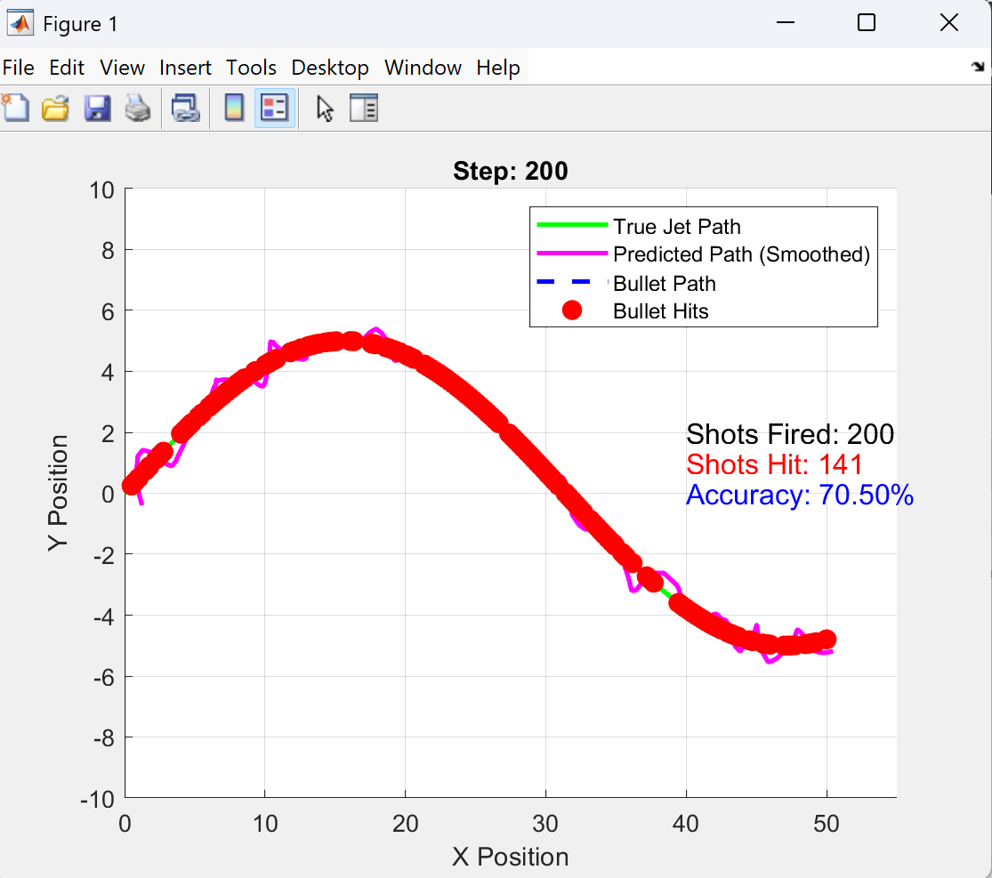
Simulation Result

Slide 9
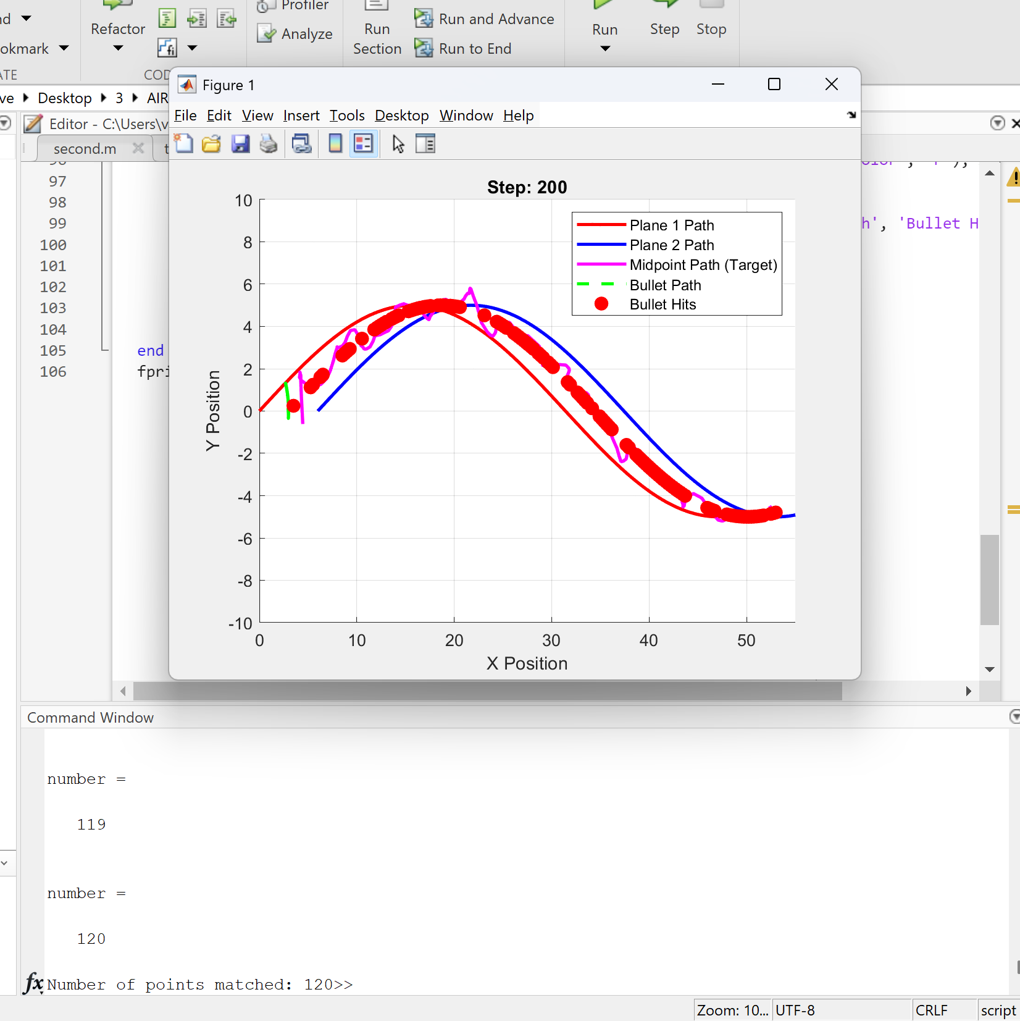
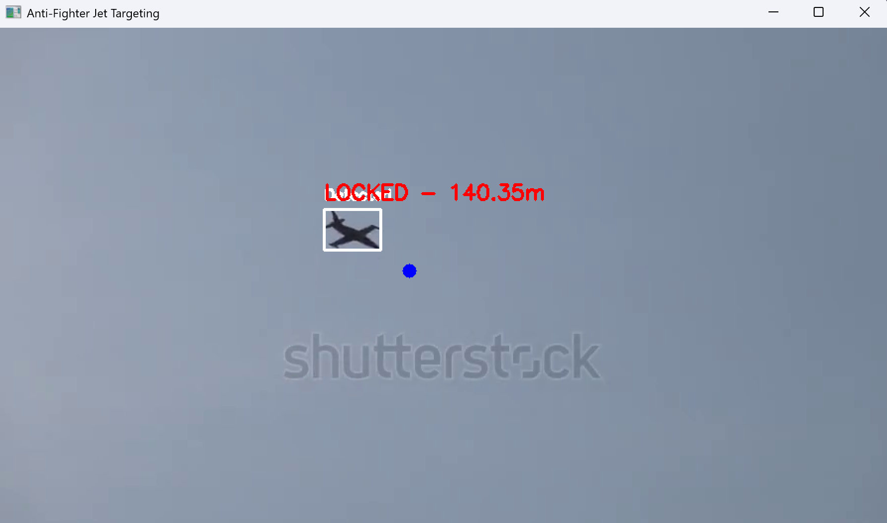

Slide 10
Conclusion
The Automated Turret System is a powerful technology that improves security, defense, and automation. It helps in protecting areas, reducing human effort, and increasing accuracy. With AI and sensors, it works faster and more efficiently than humans. As technology grows, these systems will become even smarter and more useful in different industries. In the future, automated turrets will play a key role in keeping people and places safe.
Through this simulation, we demonstrated how an automated system can track, aim, and fire with precision, adapting to sudden movements and environmental uncertainties. This technology has significant applications in defense, surveillance, and autonomous security systems, making it a crucial innovation in modern tracking systems.
Future Implementations:
Integrate a way of identifying the foe and friends in the airspace if there is a condition of wars.
Enhance the efficiency of the adaptive Kalman filter to handle high levels of random noise, ensuring better tracking even in challenging environments like electronic warfare or signal interference.
Optimize the system for resource-constrained hardware, allowing it to function effectively on older or low-end artillery systems, increasing accessibility and deployment potential.

Slide 11
References
Rigid Body Inertia Estimation Using Extended Kalman and Savitzky-Golay Filters" by Donghoon Kim, Sungwook Yang, and Sangchul Lee
Development and Flight Tests of a Kalman Filter for Navigation During Terminal Area and Landing Operations by Stanley F. Schmidt, Paul F. Flanagan, John A. Sorensen LINK-HERE

Slide 12
Thank You

